Slide 1


Group 4: Bo Haidara, Josh Mikombo, Jonathan Kim

Slide 2
Table of Contents
Artemis Description
Rationale for Creation
Examples of Stored Data
Artemis Entity-Relationship (AER)
Typical Queries and Execution Results
Difficulties/issues And Resolutions

Slide 3
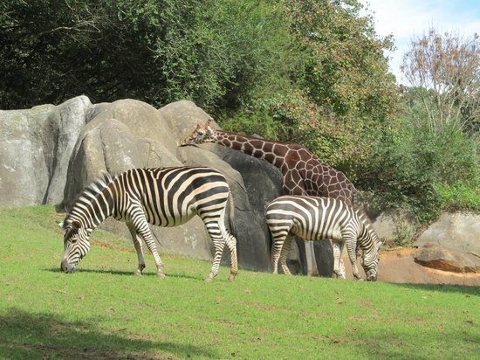
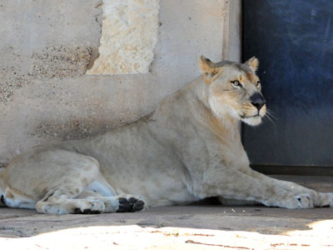
Artemis Description
Harbors animal information from real zoo locations:
Abilene Zoo - Abilene, TX
Zoosiana - Broussard, LA
North Carolina Zoo - Asheboro, NC
Links each individual animal with educational and research information:
Genomic Classifications
NCBI Genetic Data
EBSCOHOST/NCBI Scientific/Scholarly Journals
Offers a basis and a start for future expansion
Can add more zoos and update scientific data
Can be utilized and expanded upon in a variety of educational purposes
Accessible to all users throughout the entire educational and scientific fields with animal data

Slide 4
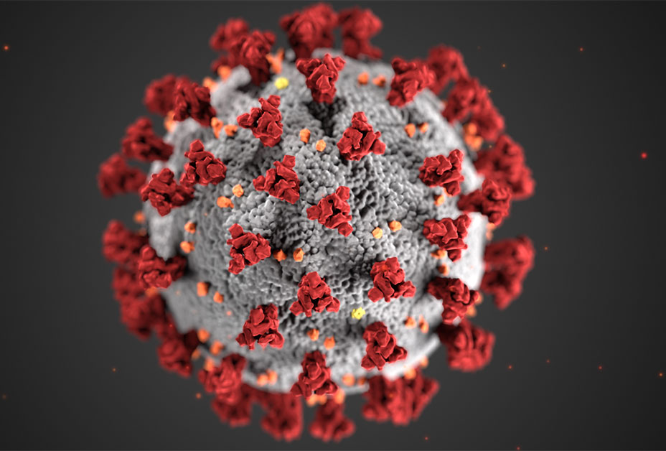
Rationale for Creation
Address limited public knowledge on zoonotic viruses and genetics
Offer accessible, comprehensible information for general public, researchers, and students
Enhance understanding of genetic traits, interactions, relations, and potential future outbreaks
Counter spread of false information during global pandemic by providing reliable data
Bridge gap between resources and zoo animals for a well-rounded education
Database features: classification, zoo locations, genetic sequences, literature references
Empower users with access to both microscopic details and general information about species
Notes:
https://www.youtube.com/watch?v=srrAwP1z6oQ see how it can tie in

Slide 5
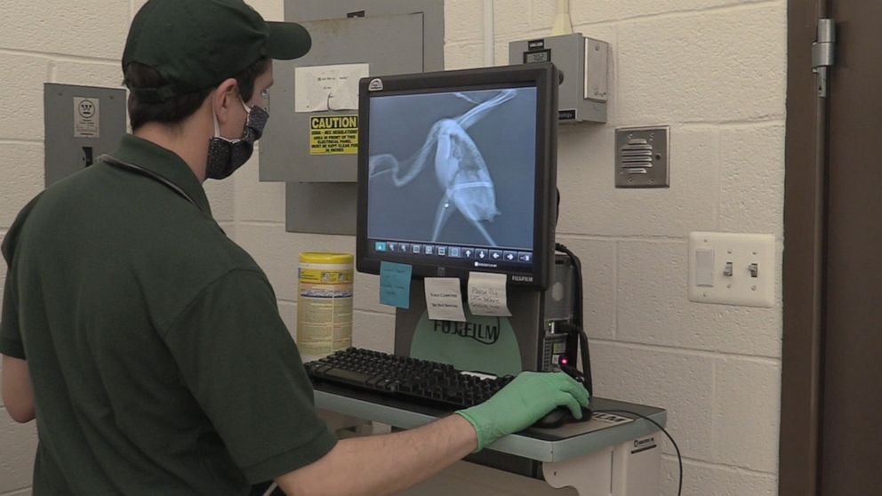

Typical Users & Purposes
Researchers and Academics:
Useful for fields of biology, genetics, zoology, and ecology
Study relationships between gene species
Explore animal classifications
Understand the literature related to various species
Zookeepers and Wildlife Conservationists:
Helpful for managing and understanding the animals under their care
Provides information on the classifications and genetics of animals
Useful for breeding programs, conservation efforts, and population management
Students:
Useful for STEM majors
Learn about different animal species, their classifications, and related scientific literature
Science Communicators and Journalists:
Research and create content about various animal species, their genetic makeup, and related scientific research
Educate the public about the importance of biodiversity and conservation efforts

Slide 6
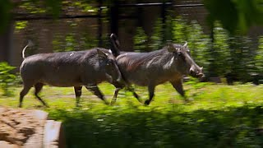
Real Life Application/Use Case
Notes:
1:14

Slide 7
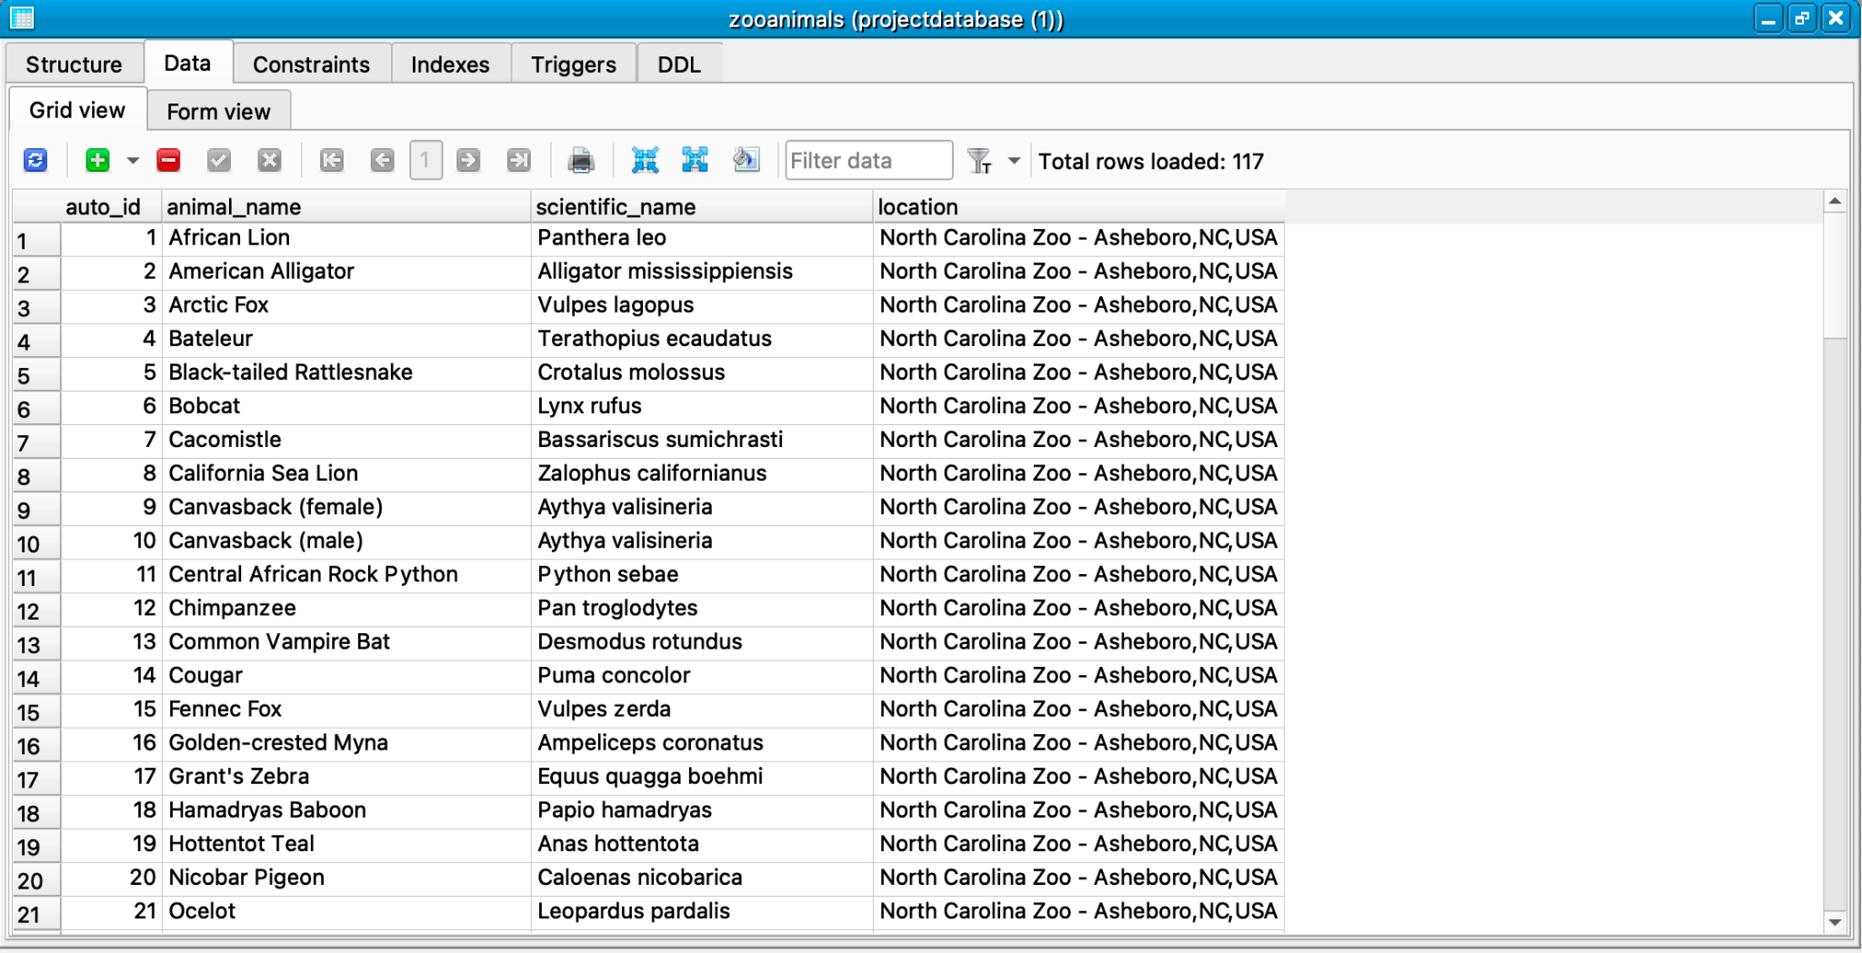
Zooanimals Stored Data
Notes:
Data of zoo animals per each zoo (3)
¼ main tables

Slide 8
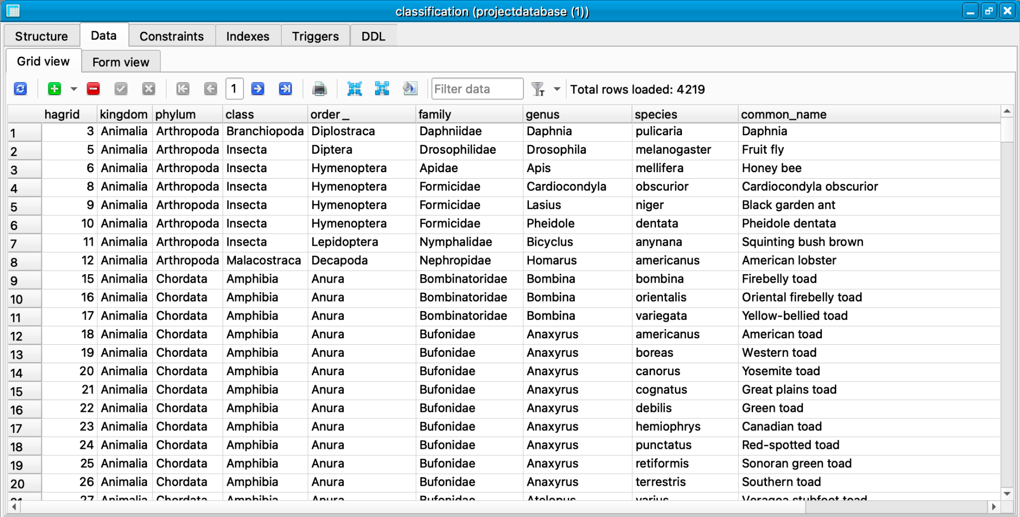
Classification Stored Data
Notes:
Animals in zoos and their classifications

Slide 9
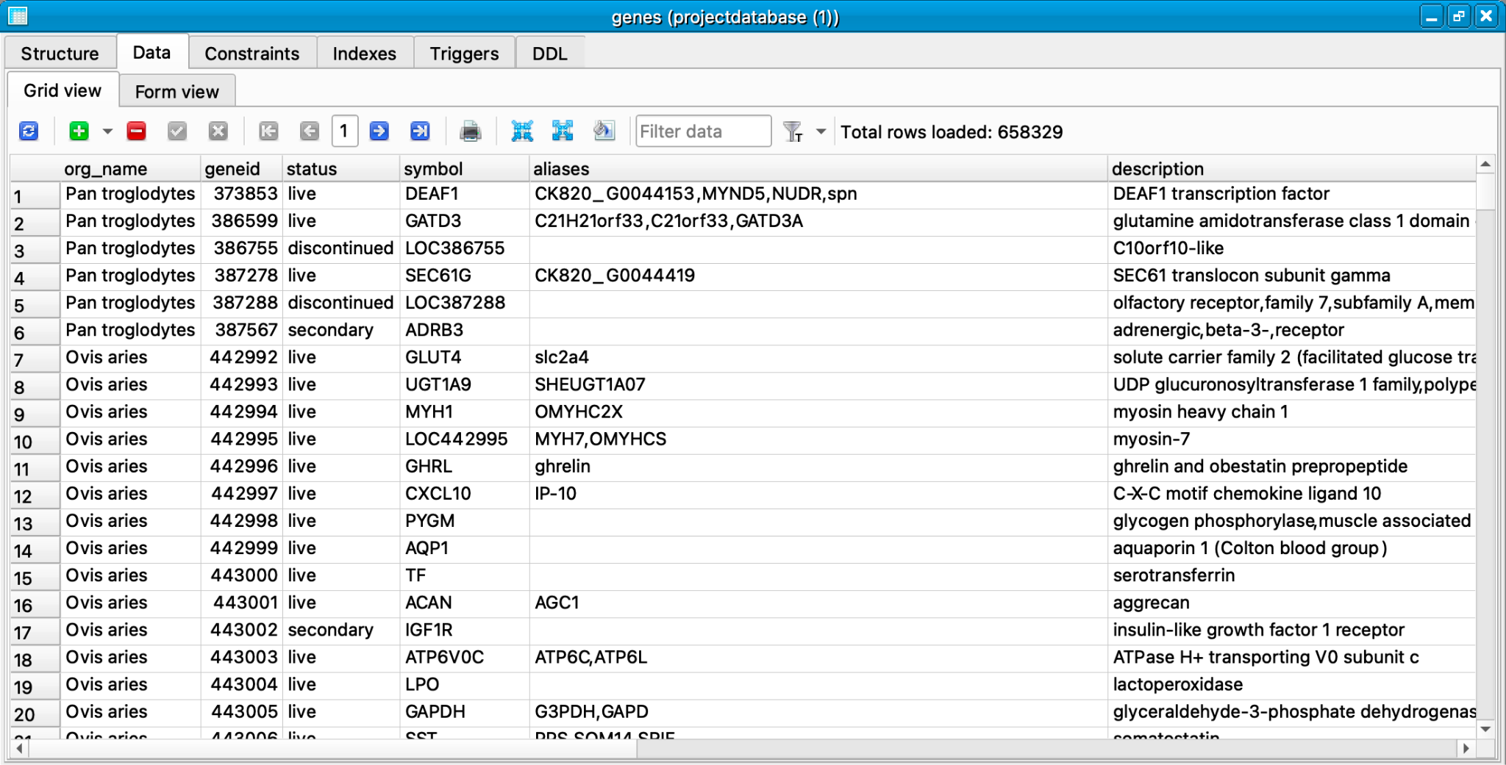
Genes Stored Data
Notes:
Genes found in the animals

Slide 10
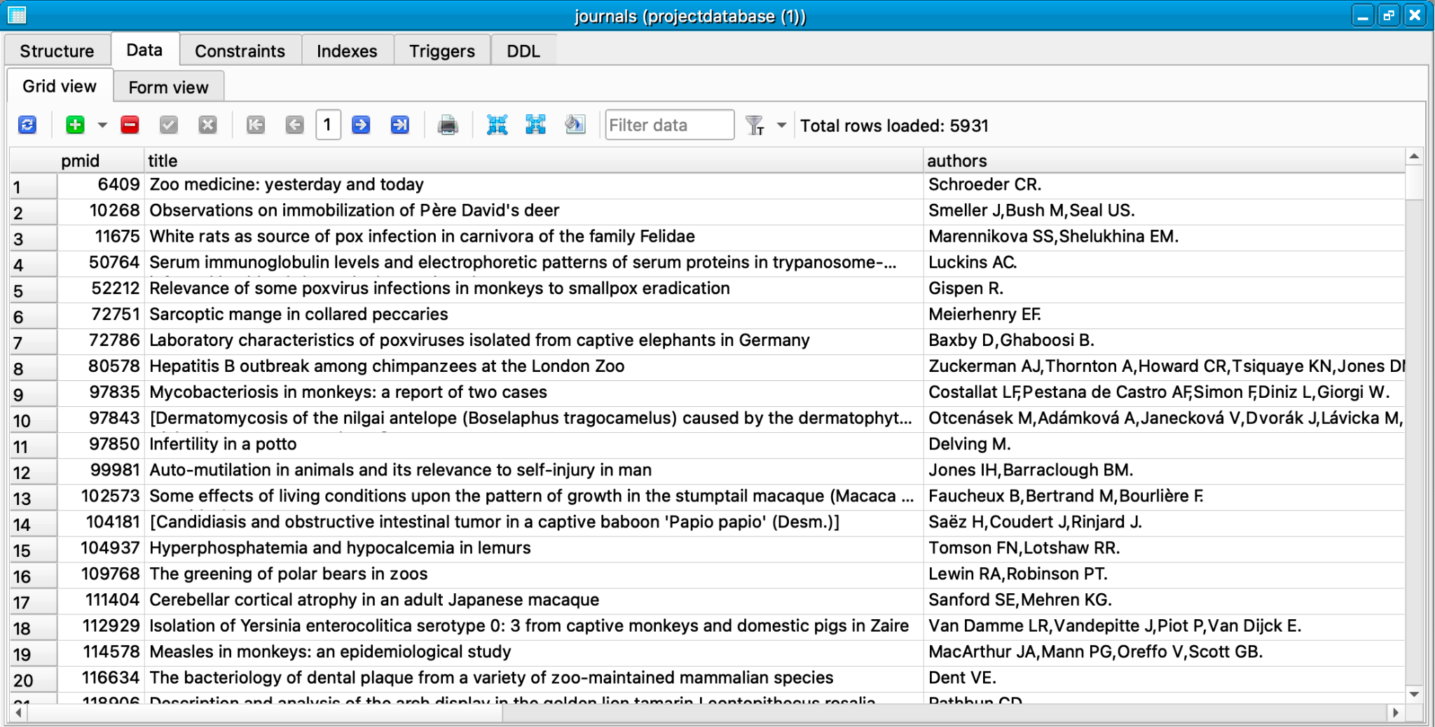
Journals Stored Data
Notes:
Journals about the animals in the respective zoos

Slide 11
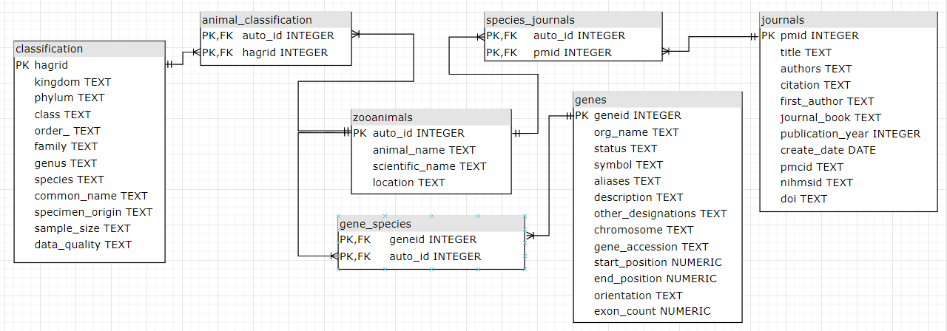
Artemis Entity-Relationship (AER)
Notes:
Animal_classification, gene_species, & species_journals are connection tables

Slide 12
Typical Queries and Results - Ex I
Query to list the top 5 journals that published articles on a given species:
SELECT DISTINCT j.pmid, j.title, j.authors, j.citation, j.first_author, j.journal_book, j.publication_year, j.create_date, j.pmcid, j.nihmsid, j.doi
FROM journals j
JOIN species_journals sj ON j.pmid = sj.pmid
JOIN zooanimals za ON sj.auto_id = za.auto_id
WHERE LOWER(j.title) LIKE '%panthera leo%'
ORDER BY j.publication_year DESC LIMIT 5;
Result:
Endometrial hyperplasia and pyometra in captive lions (Panthera leo) and tigers (Panthera tigris)
SARS-COV-2 INFECTION AND LONGITUDINAL FECAL SCREENING IN MALAYAN TIGERS (PANTHERA TIGRIS JACKSONI), AMUR TIGERS (PANTHERA TIGRIS ALTAICA ), AND AFRICAN LIONS (PANTHERA LEO KRUGERI) AT THE BRONX ZOO, NEW YORK, USA
FIRST REPORT OF ENTEROCYTOZOON BIENEUSI FROM AN AFRICAN LION (PANTHERA LEO) IN A ZOO IN THE REPUBLIC OF KOREA
Monitoring Natural SARS-CoV-2 Infection in Lions (Panthera leo) at the Barcelona Zoo: Viral Dynamics and Host Responses
Successful unilateral vasectomy reversal in a lion (Panthera leo)

Slide 13
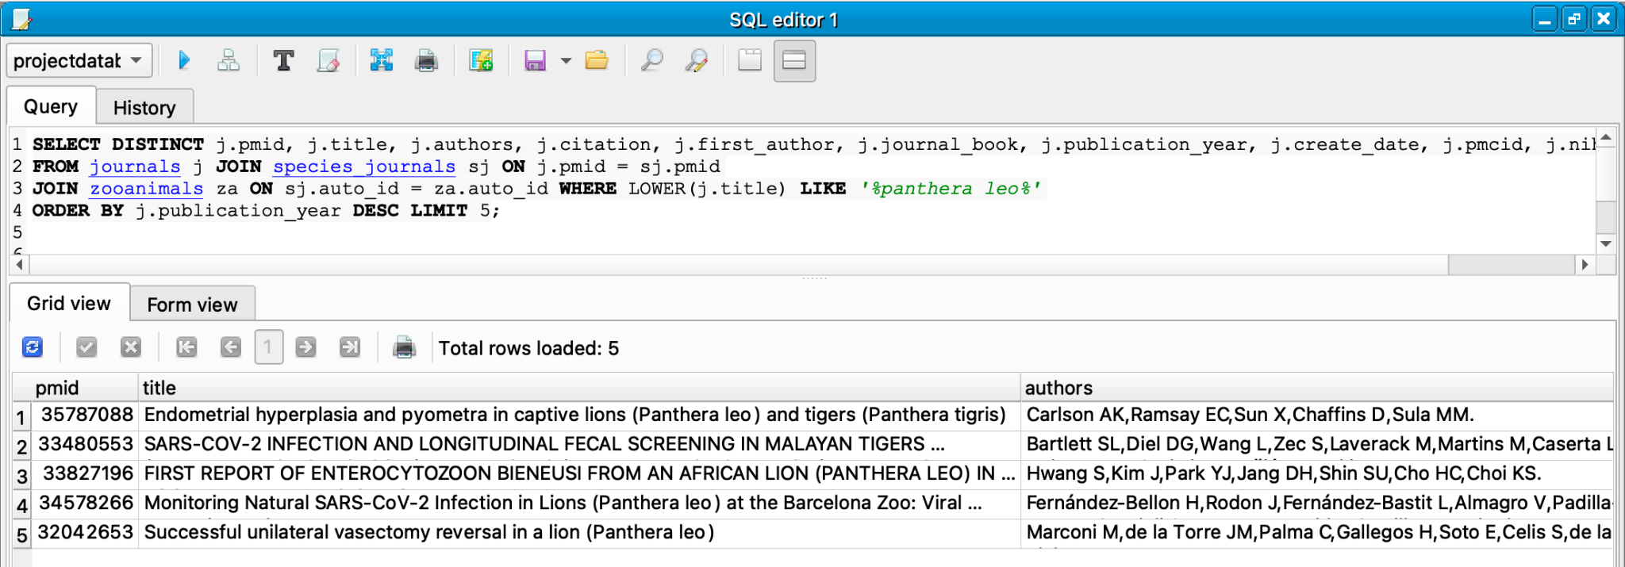
Query 1

Slide 14
Typical Queries and Results - Ex II
Query to list an animal’s genes that are associated with a certain disease:
SELECT DISTINCT g.geneid, g.symbol, g.description, g.chromosome
FROM genes g
JOIN gene_species gs ON g.geneid = gs.geneid
JOIN zooanimals za ON gs.auto_id = za.auto_id
WHERE (LOWER(g.description) LIKE '%cancer%'
OR LOWER(g.other_designations) LIKE '%cancer%')
AND LOWER(za.scientific_name) = LOWER('panthera leo');
Result:
122200377 POU2AF3 POU class 2 homeobox associating factor 3 D1
122200577 BRMS1 BRMS1 transcriptional repressor and anoikis regulator D1
122202281 NTPCR nucleoside-triphosphatase, cancer-related D2
122203653 HIC2 HIC ZBTB transcriptional repressor 2 D3
122205328 SCAI suppressor of cancer cell invasion D4

Slide 15
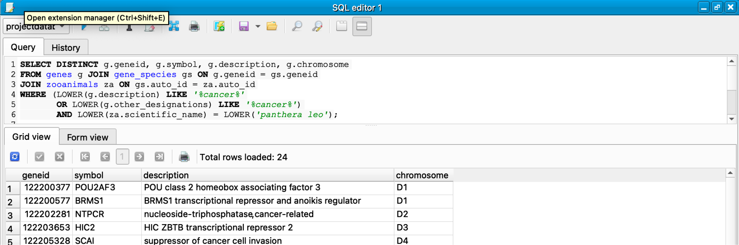
Query 2

Slide 16
Typical Queries and Results - Ex III
Query to breakdown the number of animals in each species in the database in descending order:
SELECT classification.species, COUNT(*) AS num_animals
FROM animal_classification
JOIN classification ON animal_classification.hagrid = classification.hagrid
GROUP BY classification.species
ORDER BY num_animals DESC;
Result:
mississippiensis 3
macao 2
ecaudatus 2
canadensis 2
americana 2
troglodytes 1

Slide 17
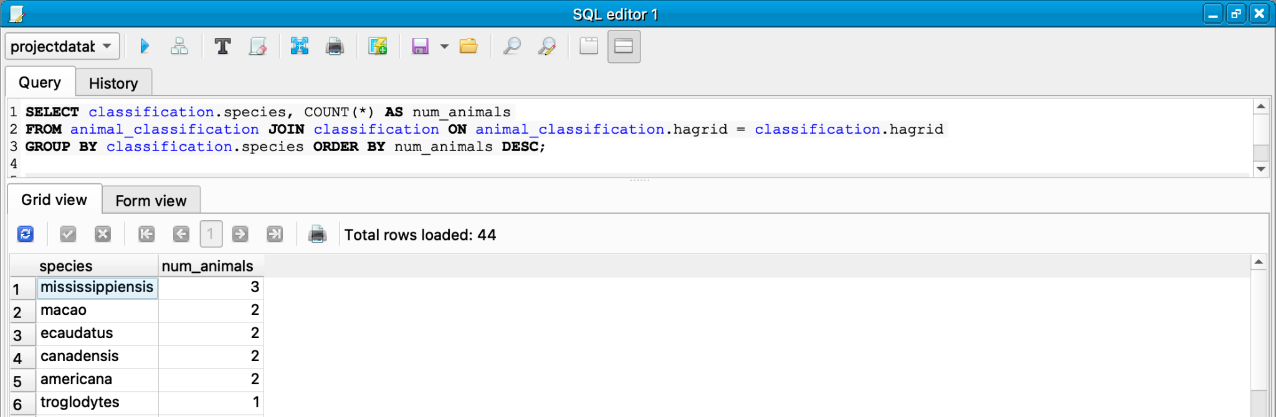
Query 3

Slide 18
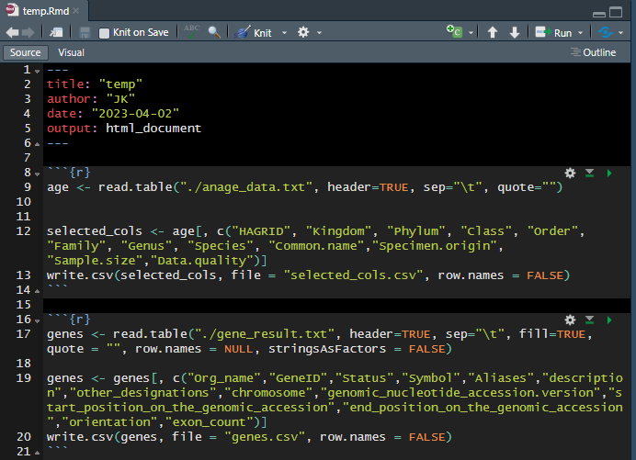
Difficulties/Issues and Resolutions
1) Finding relevant datasets and information to populate the database.
Finding websites with database-readable and not database-readable information in a format that could be translated later.
2) Translating certain files like XML and HTML into data-readable files like CSV to be imported specifically into SQLiteStudio.
Data scraped and used parsers in multiple coding languages.

Slide 19
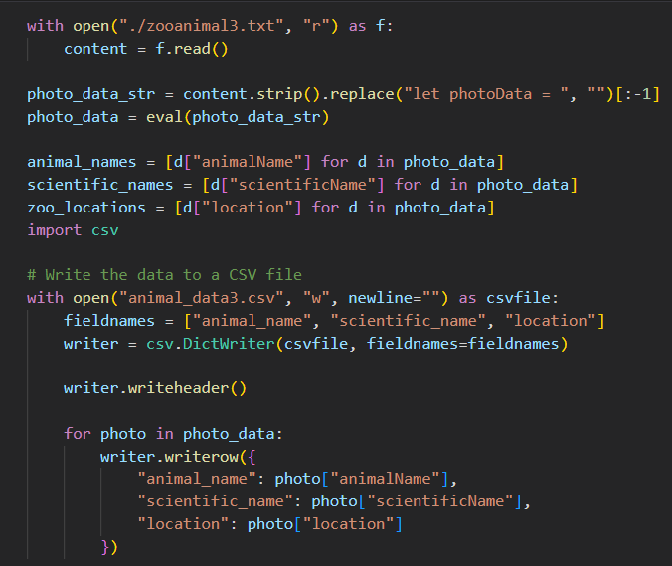
Difficulties/Issues and Resolutions
3) Selecting only certain columns from data to include data pertinent to our database rather than all columns that may not be useful for us and our users.
Used conjunction of R, Python, and SQL to solve both problems above.
4) Figuring out how to connect these separate datasets and ideas of literature, genes, and journals to the animals from a particular zoo.
Solved through creating a connecting/linking tables in between.

Slide 20
Links/References
Broussard, Louisiana (Zoosiana)
Zoosiana. (n.d.). Home. Retrieved from https://zoosiana.com/.
Asheboro, North Carolina (North Carolina Zoo)
North Carolina Zoo. (n.d.). Home. Retrieved from https://www.nczoo.org/.
Abilene, Texas (Abilene Zoo)
Abilene Zoological Gardens. (n.d.). Home. Retrieved from https://abilenezoo.org/.
ER Diagram Maker
diagrams.net. (2022, February 3). How to insert SQL into your diagrams. Retrieved from https://www.diagrams.net/blog/insert-sql.
NCBI GENES RESULT
National Center for Biotechnology Information. (n.d.). Gene - NCBI. Retrieved April 4, 2023, from https://www.ncbi.nlm.nih.gov/gene?term=%22Equus%20quagga%20boehmi%22%20%5BOrganism%5D%20OR%20%22Oxyura%20jamaicensis%22%20%5BOrganism%5D%20OR%20%22Ampeliceps%20coronatus%22%20%5BOrganism%5D%20OR%20%22Naja%20pallida%22%20%5BOrganism%5D%20OR%20%22Basiliscus%20plumifrons%22%20%5BOrganism%5D%20OR%20%22Aythya%20valisineria%22%20%5BOrganism%5D%20OR%20%22Dendrocygna%20bicolor%22%20%5BOrganism%5D%20OR%20%22Macrochelys%20temminckii%22%20%5BOrganism%5D%20OR%20%22Zalophus%20californianus%22%20%5BOrganism%5D%20OR%20%22Anser%20anser%22%20%5BOrganism%5D%20OR%20%22Erythrocebus%20patas%22%20%5BOrganism%5D%20OR%20%22Puma%20concolor%22%20%5BOrganism%5D%20OR%20%22Struthio%20camelus%22%20%5BOrganism%5D%20OR%20%22Phacochoerus%20sp.%22%20%5BOrganism%5D%20OR%20%22Leopardus%20pardalis%22%20%5BOrganism%5D%20OR%20%22Giraffa%20camelopardalis%20reticulata%22%20%5BOrganism%5D%20OR%20%22Trioceros%20melleri%22%20%5BOrganism%5D%20OR%20%22Leptailurus%20serval%22%20%5BOrganism%5D%20OR%20%22Coendou%20prehensilis%22%20%5BOrganism%5D%20OR%20%22Graptemys%20versa%22%20%5BOrganism%5D%20OR%20%22Lachesis%20stenophrys%22%20%5BOrganism%5D%20OR%20%22Bassariscus%20sumichrasti%22%20%5BOrganism%5D%20OR%20%22Python%20regius%22%20%5BOrganism%5D%20OR%20%22Leiothrix%20lutea%22%20%5BOrganism%5D%20OR%20%22Mycteria%20ibis%22%20%5BOrganism%5D%20OR%20%22Amazona%20finschi%22%20%5BOrganism%5D%20OR%20%22Panthera%20leo%22%20%
Animal aging and life history website
de Magalhães, J. P., & Costa, J. (2021). Annotated lists of mammals, birds, and fishes exhibiting extreme life spans. Retrieved April 4, 2023, from https://genomics.senescence.info/species/index.html
Animal life span information
de Magalhães, J. P., & Costa, J. (2021). Dataset of mammalian, avian and piscine maximum reported lifespan versus age at sexual maturity. Retrieved April 4, 2023, from https://genomics.senescence.info/species/dataset.zip
More zoo animal databases
Wild Welfare. (n.d.). Zoo animal databases & associations. Retrieved April 4, 2023, from https://wildwelfare.org/zoo-animal-databases-associations/
Animal article/journal references
EBSCOhost. (n.d.). Advanced search - Academic Search Complete. Retrieved April 4, 2023, from https://search.ebscohost.com/login.aspx?direct=true&AuthType=shib&db=fzh&bquery=animal&authtype=shib&type=1&searchMode=Standard&site=ehost-live&scope=site&custid=s5822979
Data scrape from HTML of online zoo website:
The Online Zoo. (n.d.). North Carolina Zoo. Retrieved April 4, 2023, from http://theonlinezoo.com/pages/north_carolina_zoo.html
The Online Zoo. (n.d.). North Carolina Zoo - Zoo Links. Retrieved April 4, 2023, from http://theonlinezoo.com/pages/north_carolina_zoo.html
NCBI journal results of animals from a zoo:
PubMed. (n.d.). Results for "'Animals, Zoo'[Mesh]". Retrieved April 4, 2023, from https://pubmed.ncbi.nlm.nih.gov/?term=%22Animals%2C+Zoo%22%5BMesh%5D&size=200

